Slide 1
OPTICAL COHERENCE TOMOGRAPHY (OCT)
PRESENTER CHAIRPERSON
DR ZIDDI LINGGI DR shijoy
1ST YEAR SENIOR RESIDENT ASSistant PROFESSOR
DEPARTMENT OF CARDIOLOGY DEPARTMENT OF CARDIOLOGY

Slide 2
references
Braunwald heart disease 12th edition
Yonetsu T, Jang IK. Cardiac Optical Coherence Tomography: History, Current Status, and Perspective. JACC Asia. 2023 Nov 28;4(2):89-107. doi: 10.1016/j.jacasi.2023.10.001. PMID: 38371282; PMCID: PMC10866736.
Subban V, Raffel OC. Optical coherence tomography: fundamentals and clinical utility. Cardiovasc Diagn Ther. 2020 Oct;10(5):1389-1414. doi: 10.21037/cdt-20-253. PMID: 33224764; PMCID: PMC7666937.
Ziad A, KG keyvan.Intracoronary optical coherence tomography: state of the art and future direction.
Lee CH, Hur SH. Optimization of Percutaneous Coronary Intervention Using Optical Coherence Tomography. Korean Circ J. 2019 Sep;49(9):771-793. doi: 10.4070/kcj.2019.0198. PMID: 31456372; PMCID: PMC6713825.
Bryniarski K, Gasior P, Legutko J, Makowicz D, Kedziora A, Szolc P, Bryniarski L, Kleczynski P, Jang IK. OCT Findings in MINOCA. J Clin Med. 2021 Jun 23;10(13):2759. doi: 10.3390/jcm10132759. PMID: 34201727; PMCID: PMC8269308.
Kakizaki, S, Otake, H, Seike, F. et al. Optical Coherence Tomography Fractional Flow Reserve and Cardiovascular Outcomes in Patients With Acute Coronary Syndrome. J Am Coll Cardiol Intv. 2022 Oct, 15 (20) 2035–2048.https://doi.org/10.1016/j.jcin.2022.08.010

Slide 3
introduction
Coronary angiography (CAG) remains the gold standard and most commonly used imaging modality for the invasive assessment of coronary artery disease (CAD)
OCT is a novel invasive imaging technique
Produces high resolution intracoronary imaging

Slide 4
Similar to IVUS but uses infrared light instead of sound
Have better resolution but poorer penetration
Resolution: 10-20 mcm axially (10x OF IVUS)
Penetration: 1-2mm

Slide 5
HISTORY

Slide 6
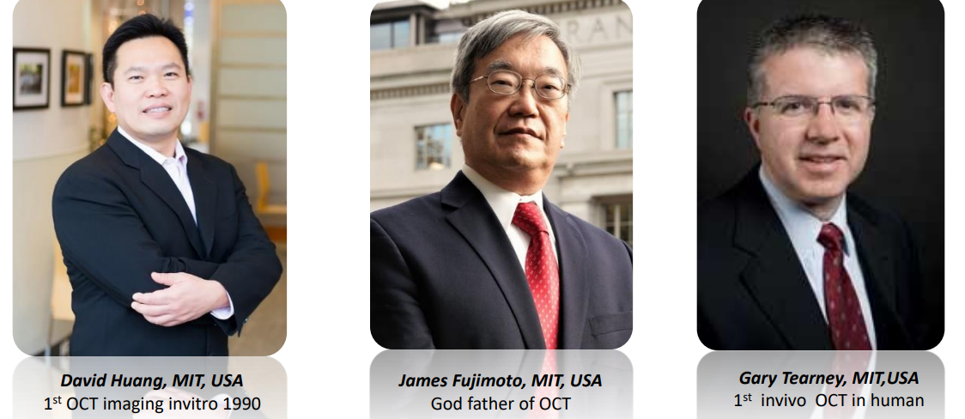

Slide 8
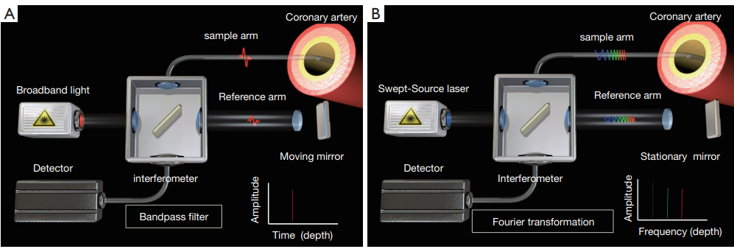
PRINCIPLE OF OCT

Slide 9
OCT catheters contain a single optical fiber that emits infrared light
measure the echo time delay and the signal intensity after its reflection or back-scattering from the coronary wall structures
uses light in the infrared spectrum with central wavelength between 1,250 and 1,350 nm

Slide 10
Interferometer is used to measure the back scattered light
It compares the backscattered light with a reference light and create a 3D image

Slide 11
backscattering
The light that get reflected back to the light producer by surface interface
The amount of backscatter light influence the intensity of image

Slide 12
ATTENUATION
Amount of light absorbed by the tissue
Affects the penetration of tissue
Lipid has high attenuation but calcium has low

Slide 13
Types of oct
1st generation( time domain oct)
2nd generation (fourier domain oct)
Occlusive technique
Uses broadband light
Moving mirror
Pullback speed: 1-5 mm/sec
Long acquisition time
Non occlusive technique
Uses wavelength swept laser
Fixed mirror
Pullback speed: 10-25 mm/sec
Short acquisition time.

Slide 14
STEPS OF PERFORMING OCT
1. Cover the pullback doc with a sterile transparent bag.
2. Remove with care the OCT image catheter from its protective sheath.
3. Purge the image catheter with 100% contrast using the dedicated purge syringe.
The catheter is sufficiently flushed when few drops of contrast are seen at the distal end of the catheter

Slide 15
Connect the catheter to the pullback DOC (drive-motor and optical controller). Make sure connection status is indicated on the mobile console screen.
Once connected, the module will perform auto-calibration.
Caution – do not flush the catheter during calibration.
5. Ensure functionality of “live view” mode prior to inserting image catheter into the vessel

Slide 16
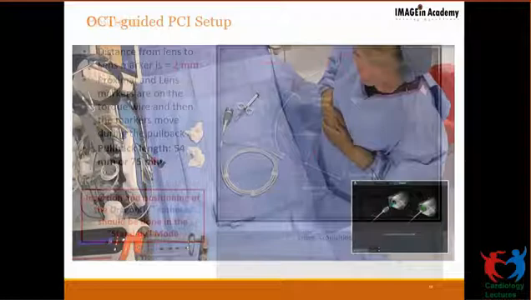

Slide 17
A 6 French guiding catheter system is preferred for optimal image with minimal contrast use.
The OCT imaging catheter is a 2.7 French rapid exchange monorail catheter, compatible with standard 0.014-inch coronary guidewires
The desired acquisition length, 75 or 54mm, is based on the indication for OCT and the need of the operator

Slide 18
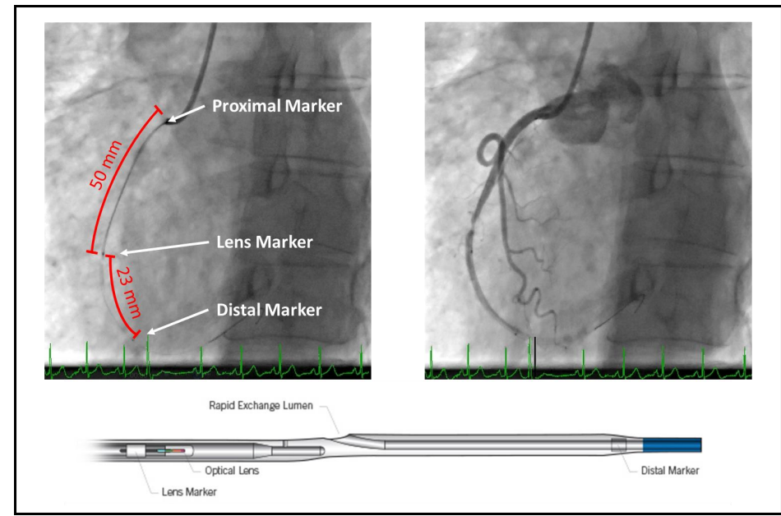

Slide 19
Contrast flushing of the desired vessel can be achieved either by manual injection using a Luer-Lock syringe or by automatic injection using an injector pump
Operators generally use a flush rate of 3-4 ml/s in the RCA and 3-5 ml/s in the left coronary artery

Slide 20
Image acquisition
make sure again that the guiding catheter is well engaged and consider administering intracoronary nitroglycerin
After checking the positioning of the catheter in the coronary vessel, press the “live view” button and real-time imaging begins

Slide 21
Press the “enable” button again to enable pullback
Inject contrast medium under cine angiography. Sufficient contrast flushing will activate the automatic trigger to start the pullback

Slide 22
PULL BACK
4 Ps
POSITION: catheter distal to the lesion
PURGE: catheter lumen
PUFF: to evaluate clearance
PULLBACK: image aquisition

Slide 23
Pullback types
Survey mode: 75mm, 5 frames/mm
High resolution mode: 54mm, 10 frames/min
Survey mode is preferred most of the time, except in cases where u need detailed evaluation like bifurcation lesions, to understand the morphology of the plaques.

Slide 24
Troubleshooting
Issue with vessel flushing
Suboptimal image due to poor blood clearance is a common occurrence
Ensure guiding catheter is adequately engaged
While using injector ensure all air is purged out and pump line is on
If problem still persists, pre-dilatation of the vessel may be required.

Slide 25
NORMAL OCT IMAGE
4 COMPONENTS
CATHETHER: CIRCULAR SPOT IN THE CENTRE
GUIDEWIRE: BRIGHT SPOT WITH WEDGE SHAPED SHADOW
LUMEN: ECHOLUSCENT
VESSEL WALL: BRIGHT-DARK-BRIGHT PATTERN

Slide 26
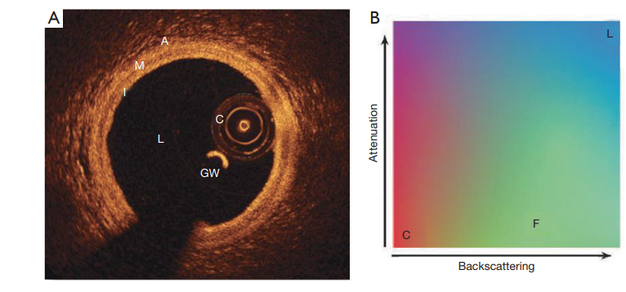

Slide 27
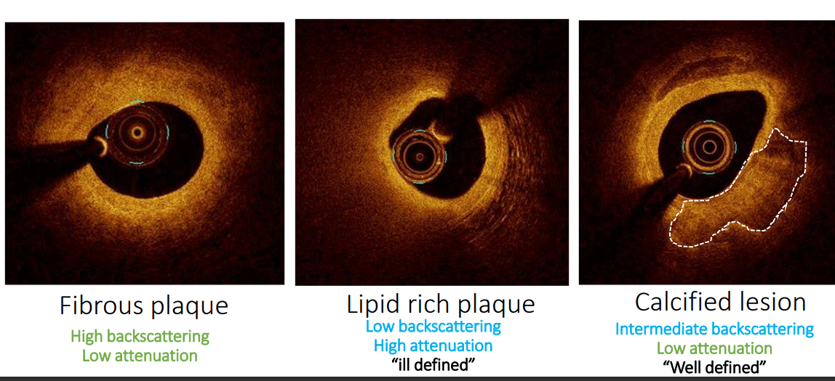
PLAQUE MORPHOLOGY IN OCT
With its high resolution, OCT is useful in determining the plaque morphology

Slide 28
OCT could differentiate plaque phenotypes of the culprit lesions
1. Pathologic intimal thickening
2. Fibroatheroma: plaques with ≥1 quadrant of lipid pool

Slide 29
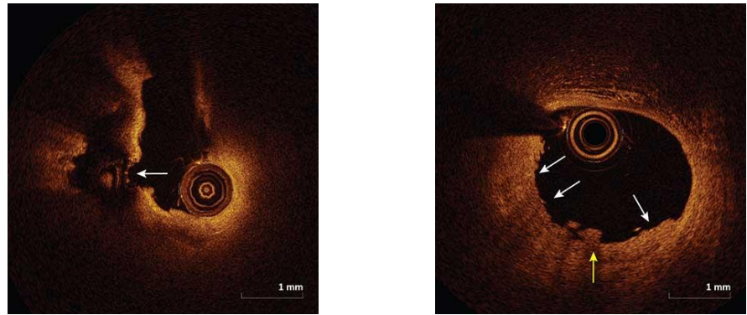
Plaque rupture
Disruption of fibrous cap
intraplaque cavity communicating with lumen
Plaque erosion:
Disruption of endothelial covering
Fibrous cap intact

Slide 30
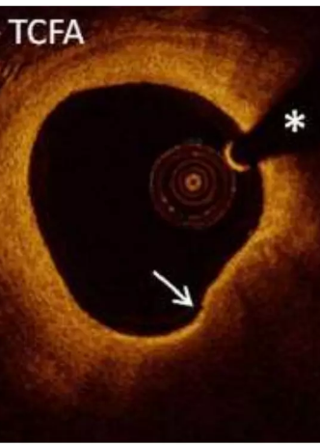
VULNERABLE PLAQUE
Thin capped (<65 micrometre)
High lipid content
Macrophage infiltration

Slide 31
CALCIFIC PLAQUES IN OCT

Slide 32
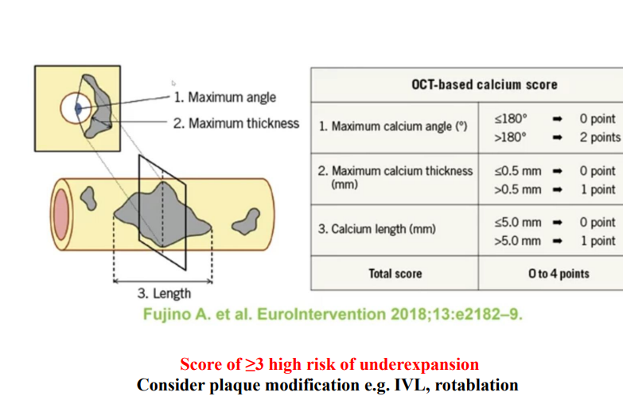

Slide 33
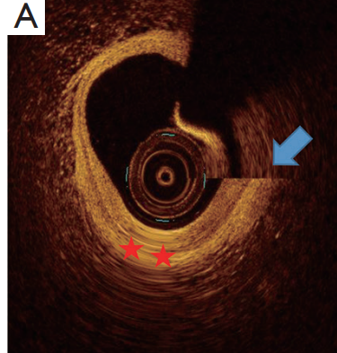
Artifacts in OCT imaging
Nonuniform rotational distortion (NURD)
results from uneven drag or friction on the drive cable
distortion in the image that conceals the structures in that part of the circumference
due to tortuosity or acute bends in the artery,
tight stenosis
heavy calcification
small guiding catheter

Slide 34
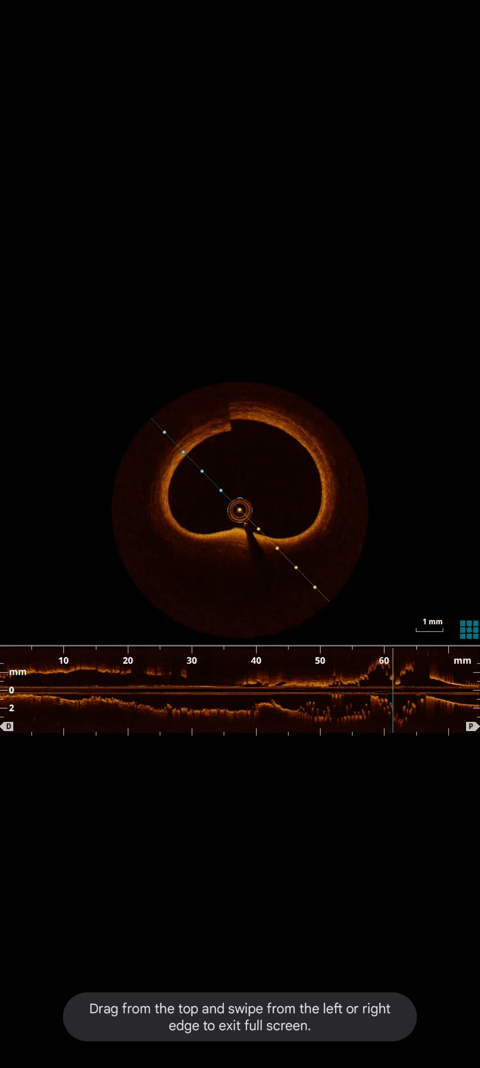
Sew-up artifacts
Rapid movement of the artery or the imaging catheter
causes malalignment along the circumference of the image

Slide 35
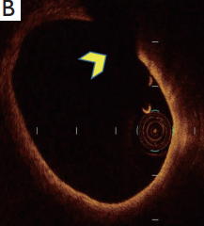
Obliquity
when the vessel is large in size and in vessel curvature, the catheter alignment is non-coaxial and the resulting image appears elliptical.
makes the measurements inaccurate

Slide 36
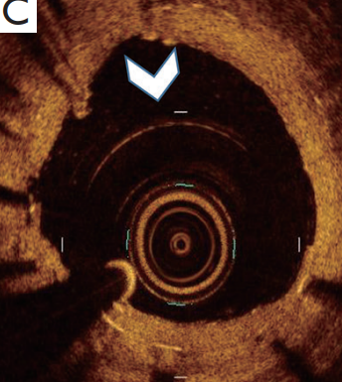
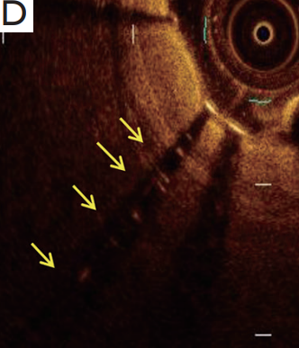
Shadow artifact
commonly occurs with guide wires and stent struts
air bubbles, red thrombus, blood and macrophage accumulations cause shadowing on OCT imaging
Multiple reflections and Reverberations
repeated reflections may happen between the transducer and the reflecting surface.
may happen within the facets of the imaging catheter that produce circular lines around the catheter or with stent struts that result in reverberation

Slide 37
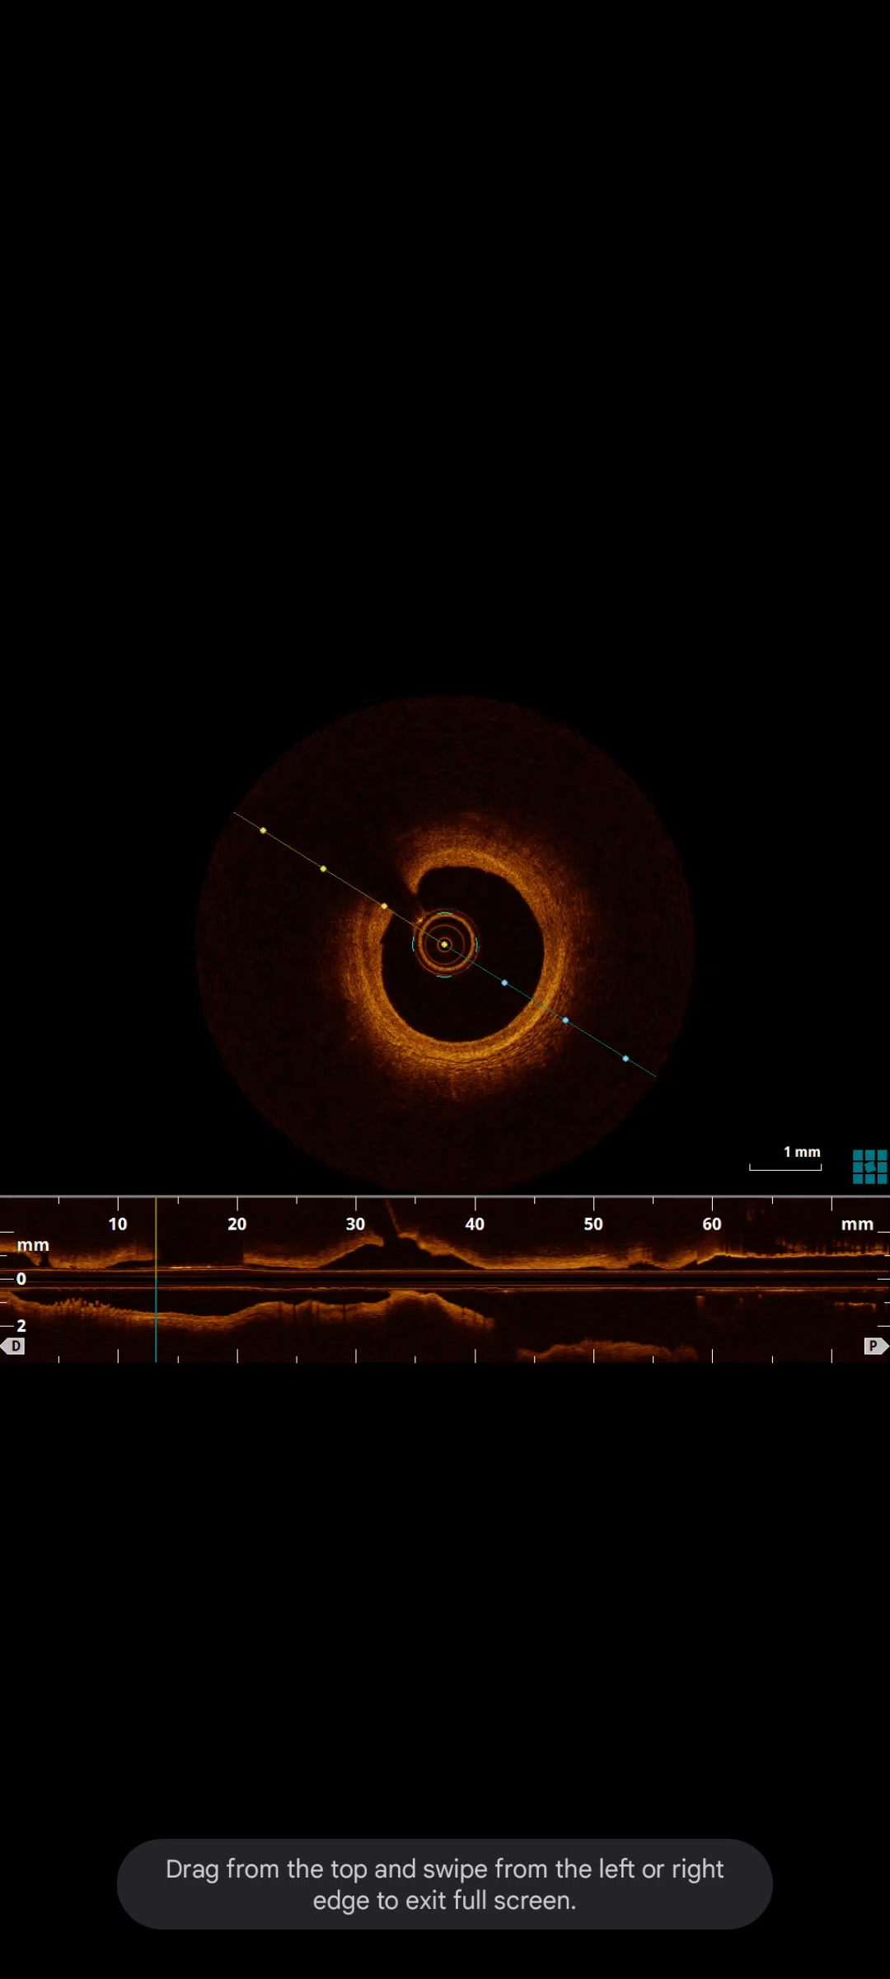
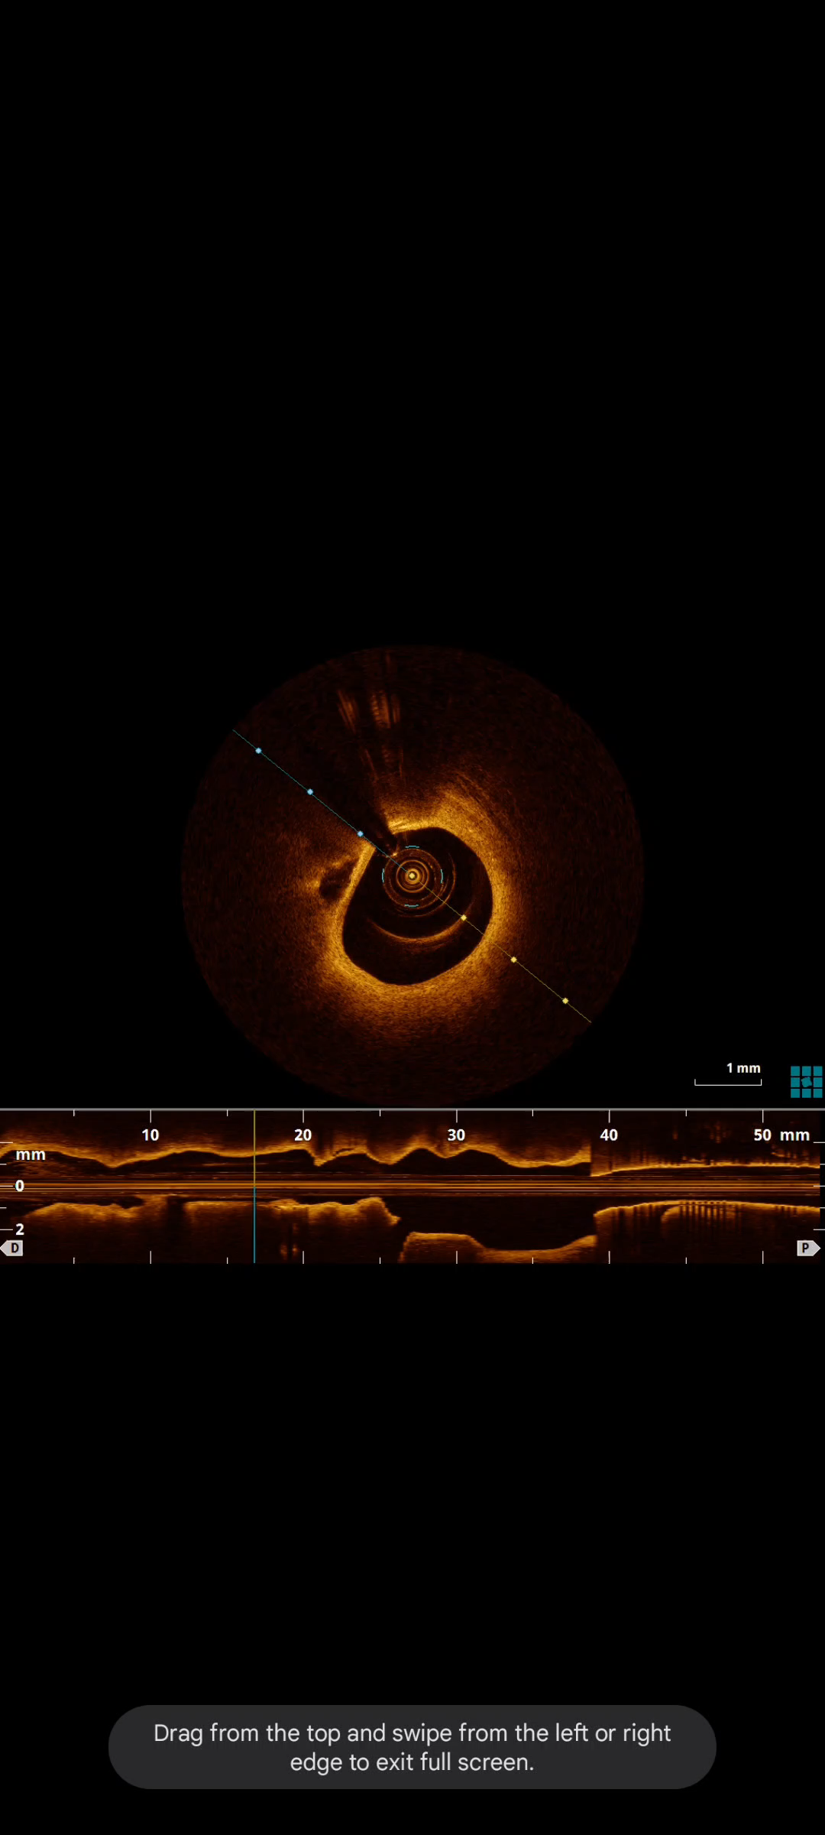

Slide 38
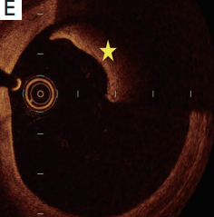
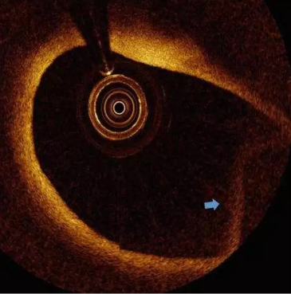
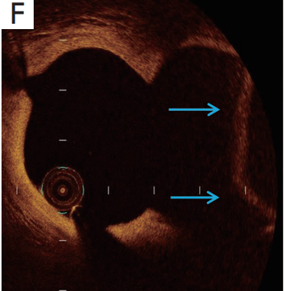
Residual blood artifact
Suboptimal vessel flushing
misinterpreted as red thrombus
cause shadowing of the underlying structures.
Fold over artifact
light is reflected from areas of vessel beyond this range
gives an appearance of the far field area of the vessel folded over in the image
artifact occurs commonly with large vessels or at areas of side branches

Slide 39
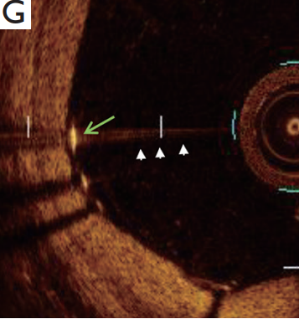
Saturation artifact
abnormally bright A-lines that appear when the high amplitude backscattered signals from specular structures like stent struts and guidewire saturate the processing limit of the detector
Blooming
Stent struts reflect light intensely and hence only the leading edge is visible on OCT images.
high signal density at the surface causes a glare or axial stretching of the stent strut reflections called blooming

Slide 40
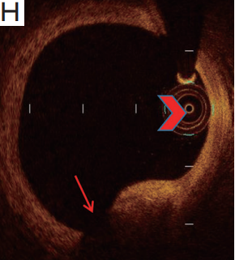
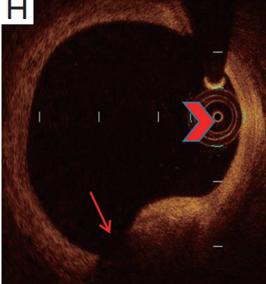
Proximity artifact
artificial increase in the brightness of the tissues adjacent to an eccentrically positioned imaging catheter
Tangential signal dropout
resulting from the eccentric catheter position
he incident light rays are parallel to the surface of the vessel wall rather than perpendicular to it
results in artificial signal attenuation in the deeper parts of the vessel wall.
With a signal rich surface and attenuated deeper tissues, this gives a false appearance of a TCFA

Slide 41
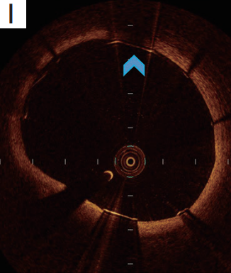
Merry-go-round effect
apparent elongation of stent struts in the lateral direction
results from reduced lateral resolution
either from increased distance between the A-lines or larger beam spot diameter in the far field or increased scattering of the light in the lumen by red blood cells by incomplete flushing

Slide 42
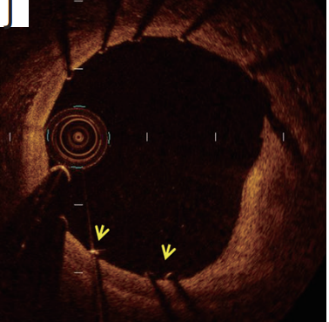
Sunflower effect
The resultant image reconstruction orients the strut perpendicular to the catheter similar to orientation of sunflowers toward the sun.
Sunflower effect gives an appearance of strut malapposition and artificially increases strut to vessel wall distance

Slide 43
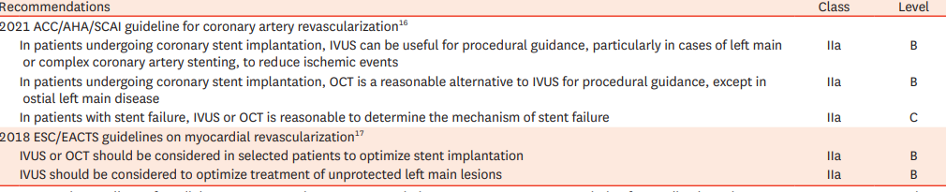
CURRENT GUIDELINE RECCOMENDATION ON OCT

Slide 44
ALGORITHMIC APPROACH

Slide 45
PRE PROCEDURE OCT
Morphology
Length
Diameter

Slide 46
Morphology

Slide 47
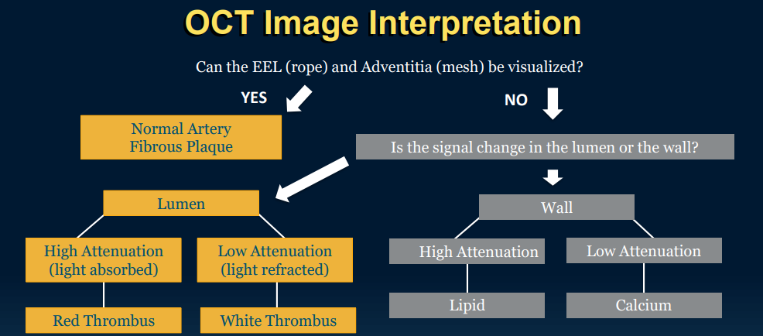

Slide 48
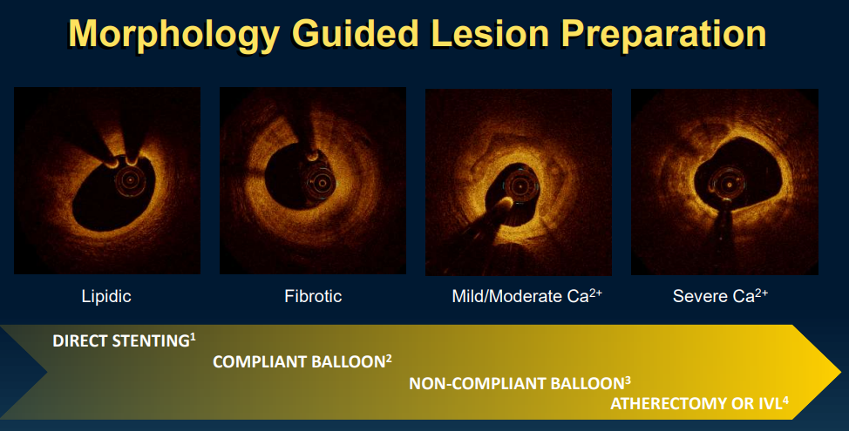

Slide 49
Length
Identify the proximal and distal reference point
the most normal appearing segment within 5mm are selected as reference frame
Length of stent is automatically calculated by the machine

Slide 50
DIAMETER
Ideally distal reference point should be used for calculating diameter of the stent
EEL-EEL should be used for calculation
EEL-EEL diameter can only be considered if EEL is visible over 180⁰
If EEL not visible then luminal diameter at distal reference point can be taken

Slide 51
EEL-EEL is better as it leads to larger stent expansion
If luminal area is used then stent has to be upsized by 0.25-0.5mm

Slide 52
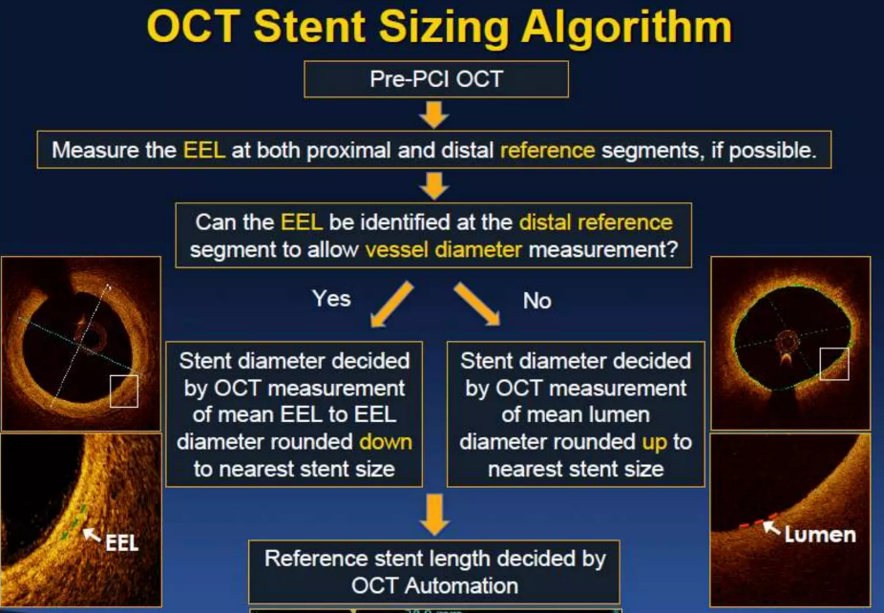

Slide 53
POST PCI OCT
Medial dissection
Apposition
eXpansion

Slide 54
Medial dissection
OCT has high utility in identifying medial stent dissection
It can identify the length as well as degree of medial dissection
OCT criteria for major dissection
Dissection length of >3mm
Dissection arc > 60⁰

Slide 55
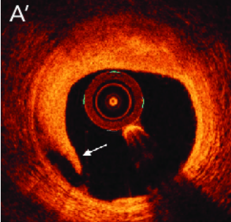
Dissection at the distal edge should be ideally stented

Slide 56
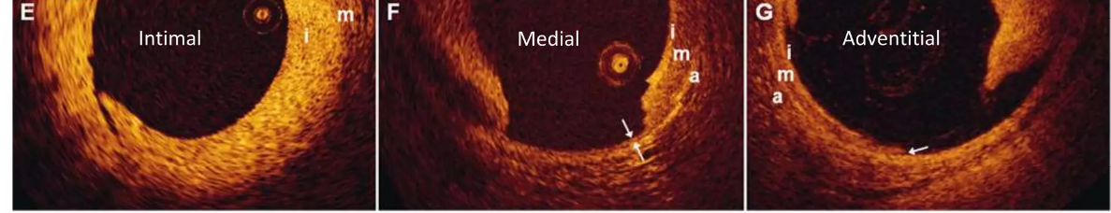

Slide 57
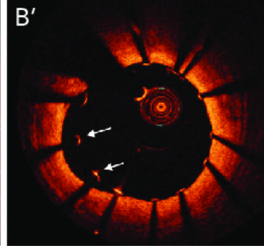
APPOSITION
Malapposition: lack of full contact between stent struts and vessel wall
Stent malapposition is a common finding on OCT after stenting
IF >3MM IN LENGTH AND ≥0.3MM FROM WALL

Slide 58
eXpansion
A stent is said to be well expanded if lumen in stented segment is close or greater than the normal reference lumen
Ideally MSA should be ≥90%
MSA ≥ 80% is acceptable

Slide 59
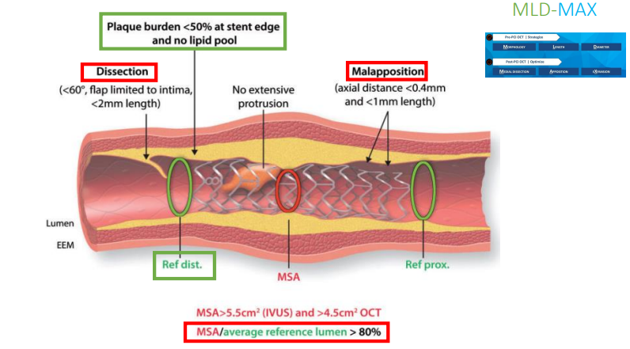

Slide 60
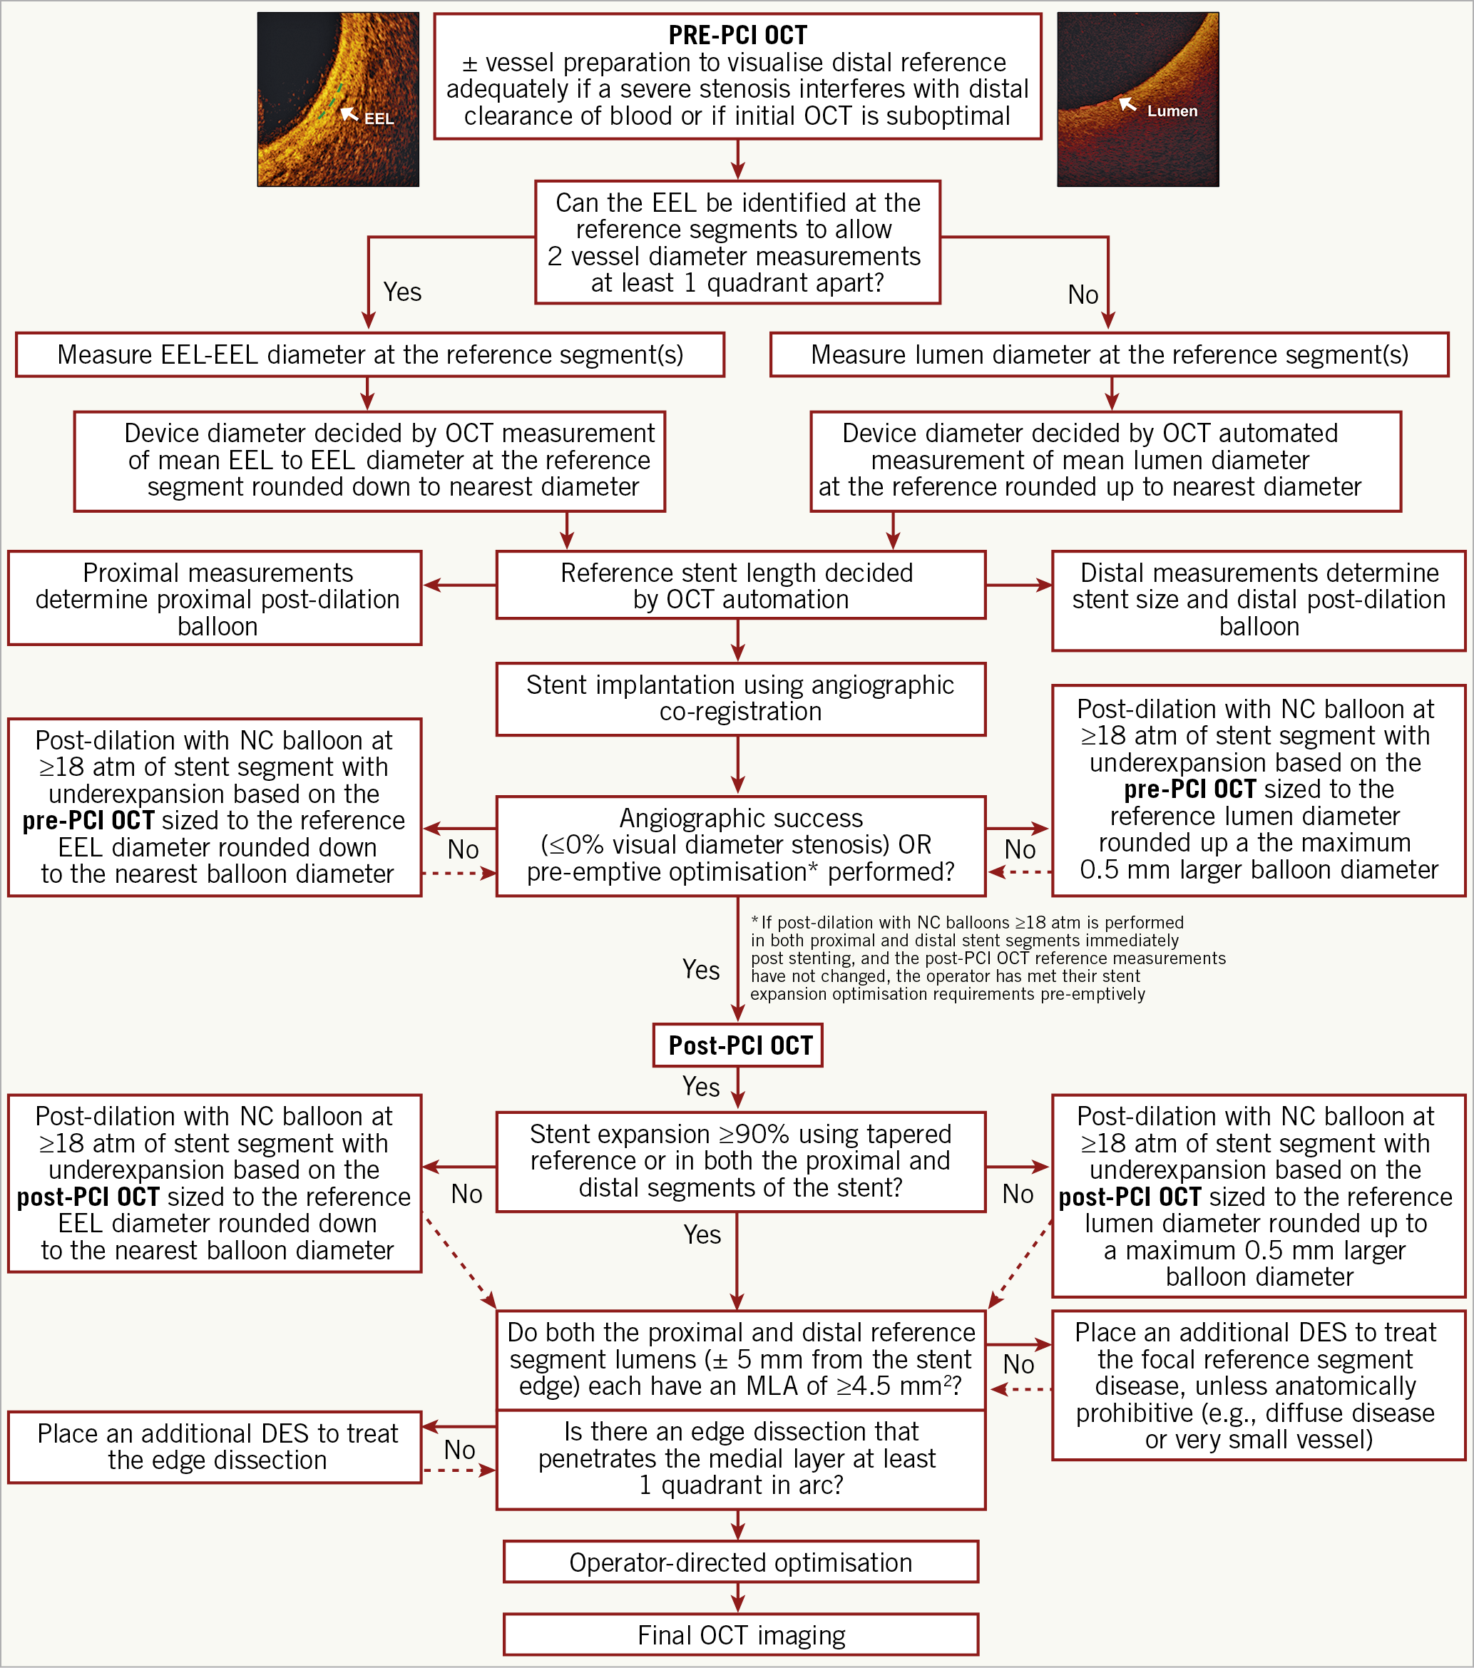

Slide 61
OCT in ACS
Cause of ACS
1.plaque rupture
2. plaque erosion
3. eroded Calcium nodules

Slide 62
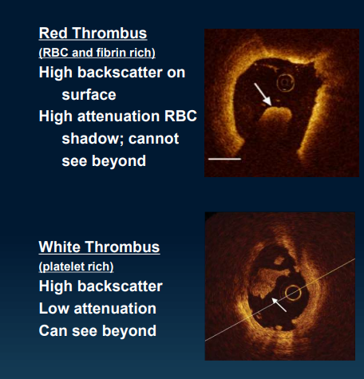
THROMBUS IN OCT

Slide 63
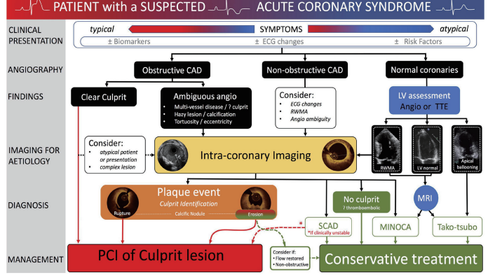

Slide 64
OCT IN SCAD
Double lumen
Intimal disruption
Intramural hematoma
Entry and exit tear
Length of the dissection

Slide 65
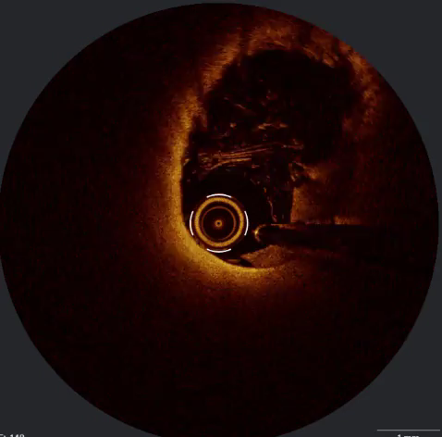

Slide 66
OCT IN MINOCA
In 30% cases of ACS no culprit lesion could be found
10% cases have multiple culprit
recent SOFT-MI study coronary plaque disruption and thrombus were present in 24% and 18% of MINOCA patients respectively
OCT with its high resolution have been found to useful in identifying lesions associated with MINOCA.

Slide 67
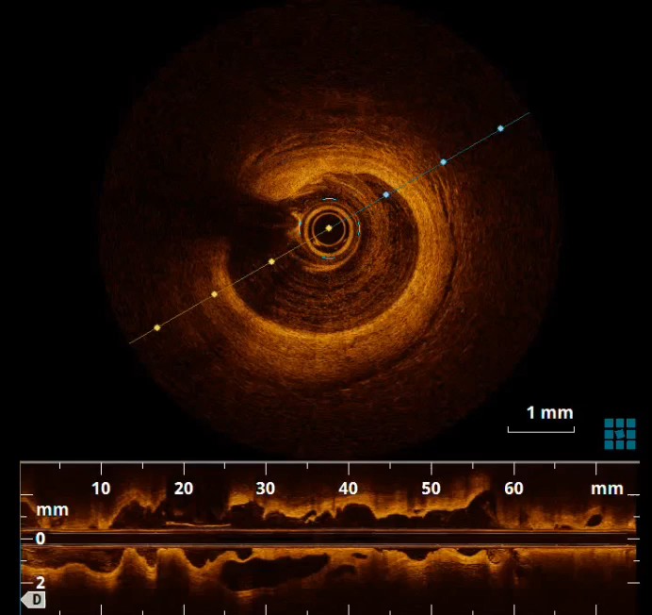
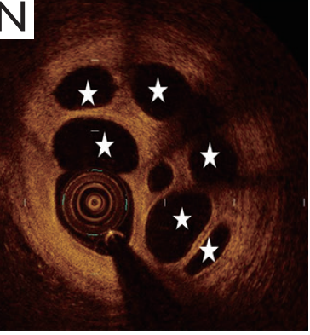
OCT of recanalized thrombus

Slide 68
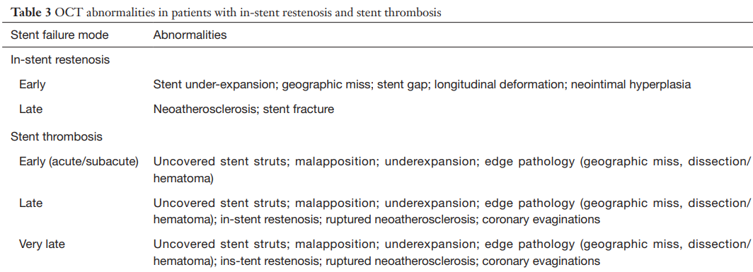
OCT IN STENT FAILURE

Slide 69
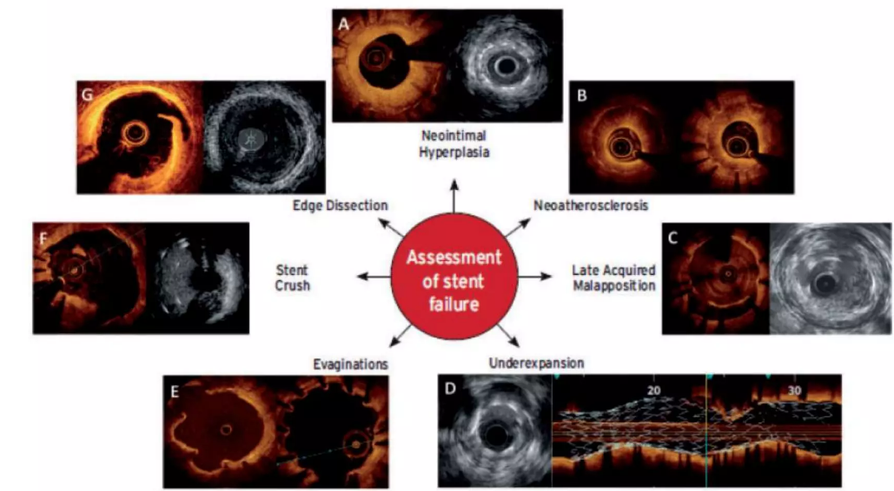

Slide 70
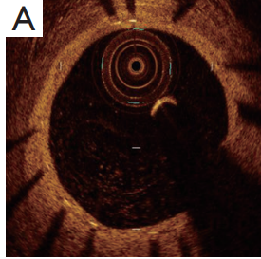
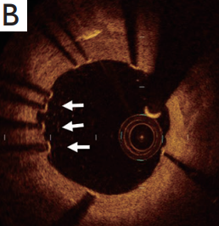
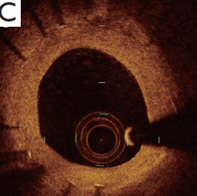
Use of OCT in stent failure
Thin homogenous neointima coverage
Uncovered struts
Homogenous neointimal growth

Slide 71
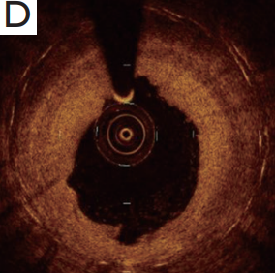
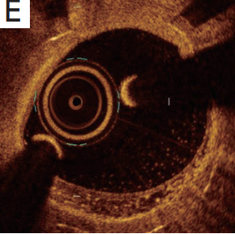
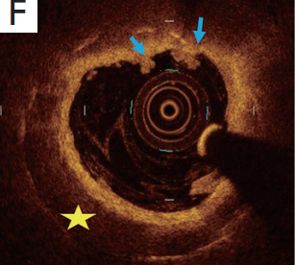
Layered pattern
Heterogenous pattern
neoatherosclerosis

Slide 72
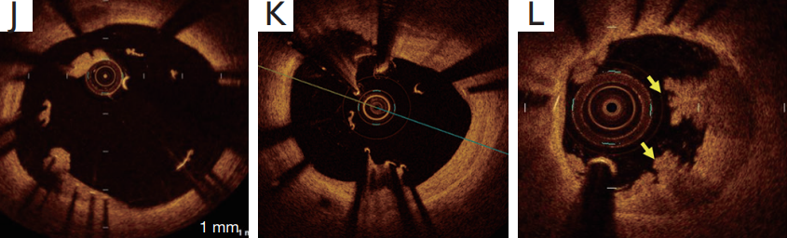
Malapposed stent

Slide 73
OCT IN BIFURCATION LESIONS
Accounts for 15-20% of all PCI
Inferior procedure success rate and higher complication risks
Role of OCT
1. prediction of side branch compromise
2. assessment of the jailed SB ostium and confirmation of optimal SB wire re-crossing
3. stent size selection and stent optimization.

Slide 74
OCT VS IVUS

Slide 75
TRIALS DONE WITH OCT

Slide 76
Oct ivus hybrid
  Combines two modalities together
  Both of them complement each other
  Details of OCT and depth of IVUS
  1st developed in 2010 and is being evolving since then

Slide 77
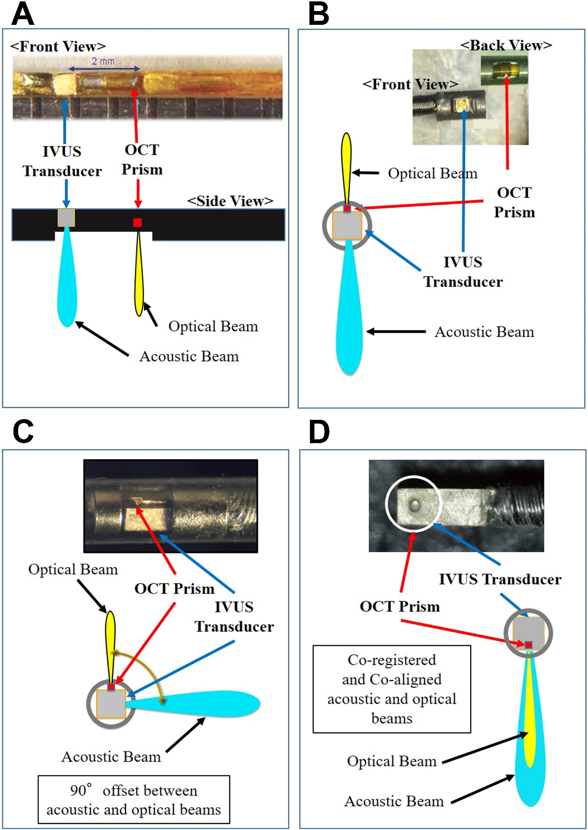

Slide 78
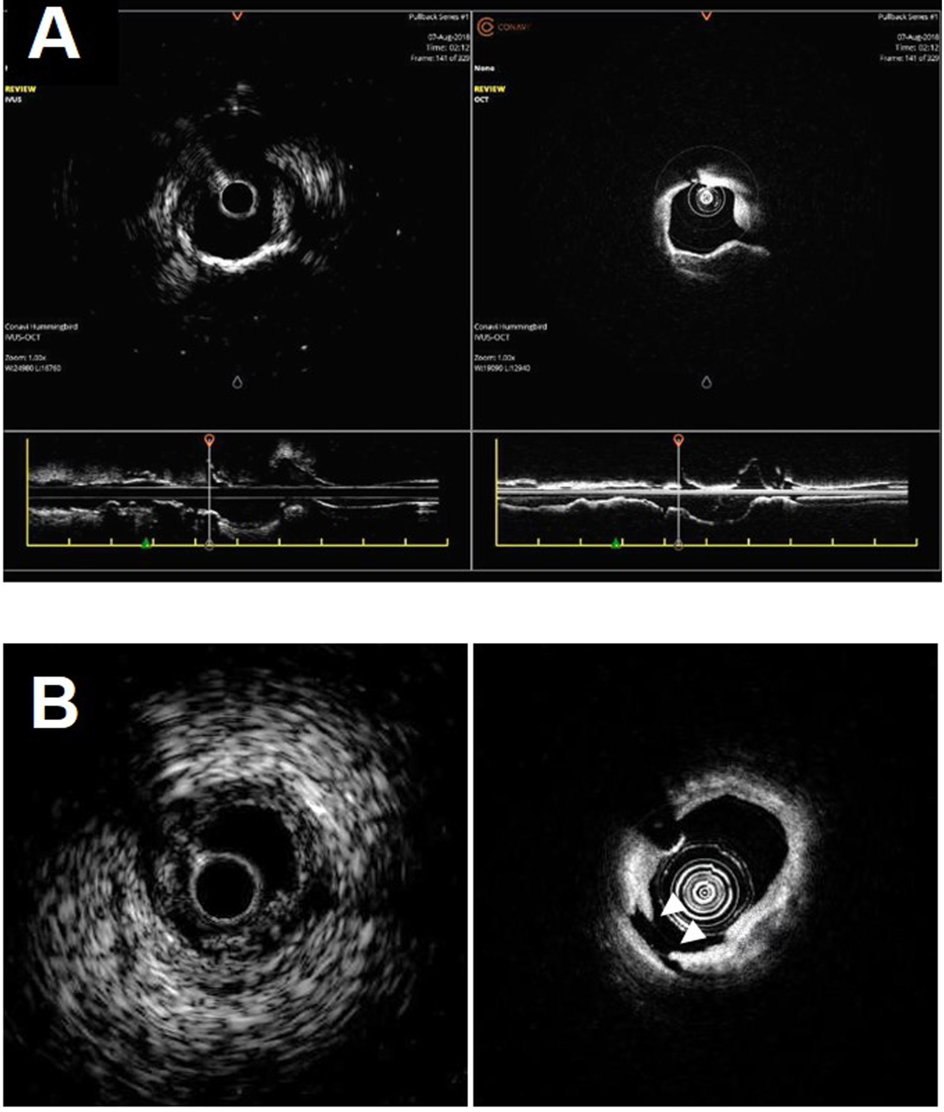
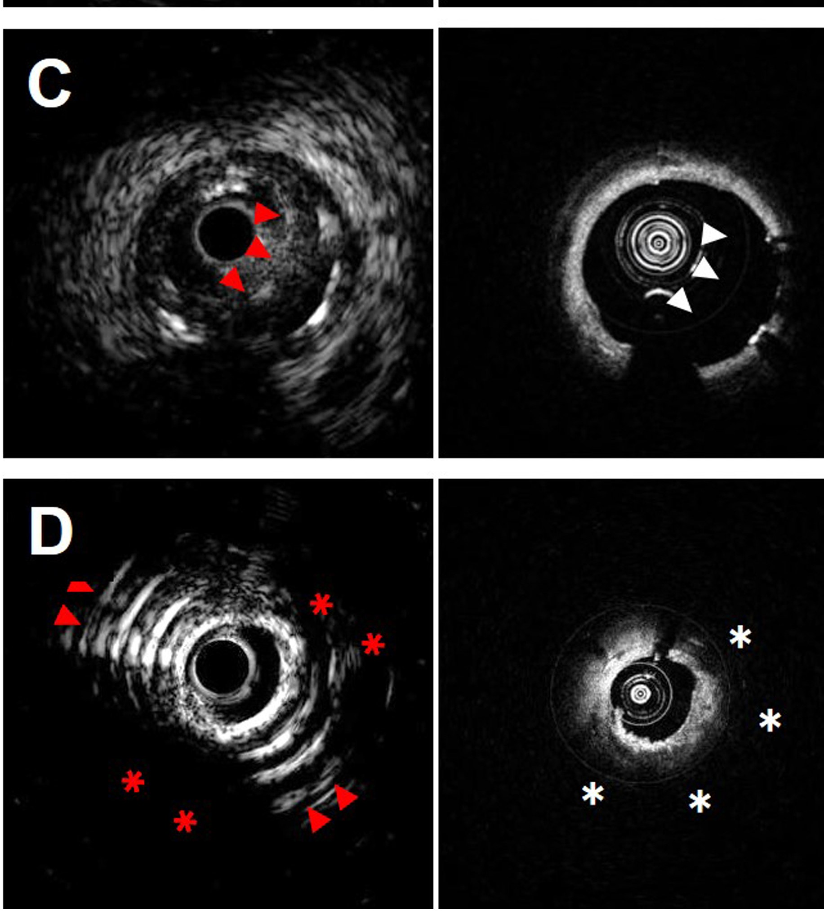

Slide 79
ZERO CONTRAST OCT
OCT use in CKD patient has been excluded due to use of high amount of contrast
Possibly leading to CIN
Zero contrast OCT is being evolving intervention technique where minimal or zero contrast is used for imaging
Rather solution like low molecular weight dextran or normal saline is used
Imaged acquired are comparable to that of contrast OCT

Slide 80
LIMITATION OF OCT
Aorto-ostial lesions
Ectatic tortuous vessels
Live guidance in CTO
Renal impairment

Slide 81


Slide 82


Slide 83
THANK YOU

